Slide 1
Predict Future Sales
By Cesar Miranda

Slide 2
Goal, Benefits and Datasets
1

Slide 3
“Predict the number of products that each store is going to sell the next month (Nov 2015)”

Slide 4
Benefits
Have the sufficient stock to cover the volume of sales.
Take the possible decision to retire the product of the store because of the low level of sales.
Improve the sales plan the company has for each store.

Slide 5
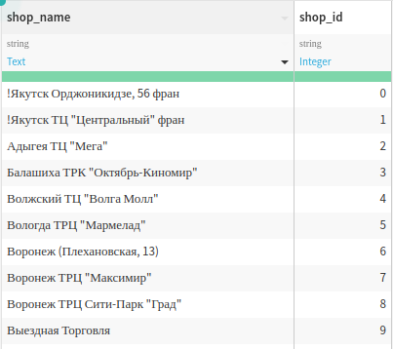
Place your screenshot here
Shop Dataset
List of all shops of the company.

Slide 6
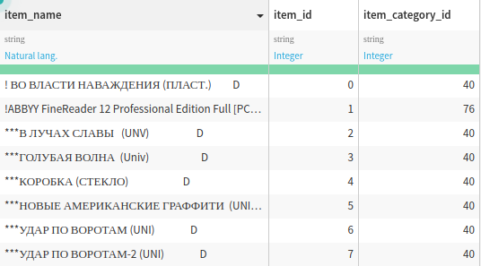
Place your screenshot here
Items
List of items that are sold in all stores.

Slide 7
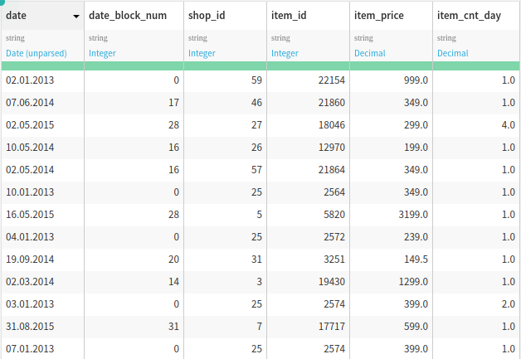
Place your screenshot here
Sales Dataset
Show the number of items each stores has sold since 2013.

Slide 8
Deliverable
2

Slide 9
“A model that can predict the number of products that are going to be sold the next month with at least 60% of accuracy”

Slide 10
How to achieve the deliverable
3

Slide 11
Analize & generate the features for each dataset.
Consolidate the daily information to monthly.
Use the algorithm with the best score to generate the model

Slide 12
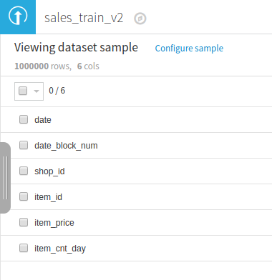
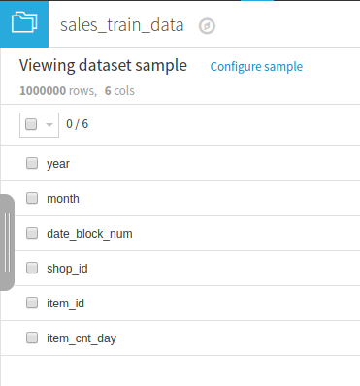
Analize & Add features

Slide 13
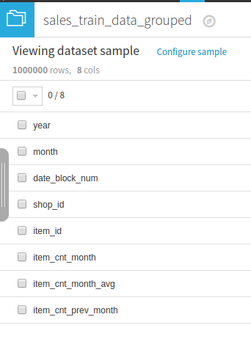
Daily data to monthly

Slide 14
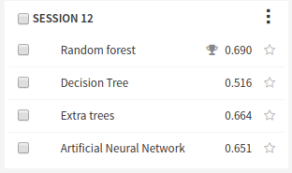
Algorithm with the best scored

Slide 15
Ethical Implications
4

Slide 16
Do not show the data of customer to anyone who does not belong to the project.

Slide 17
Thanks!
Any questions?

